Slide 1
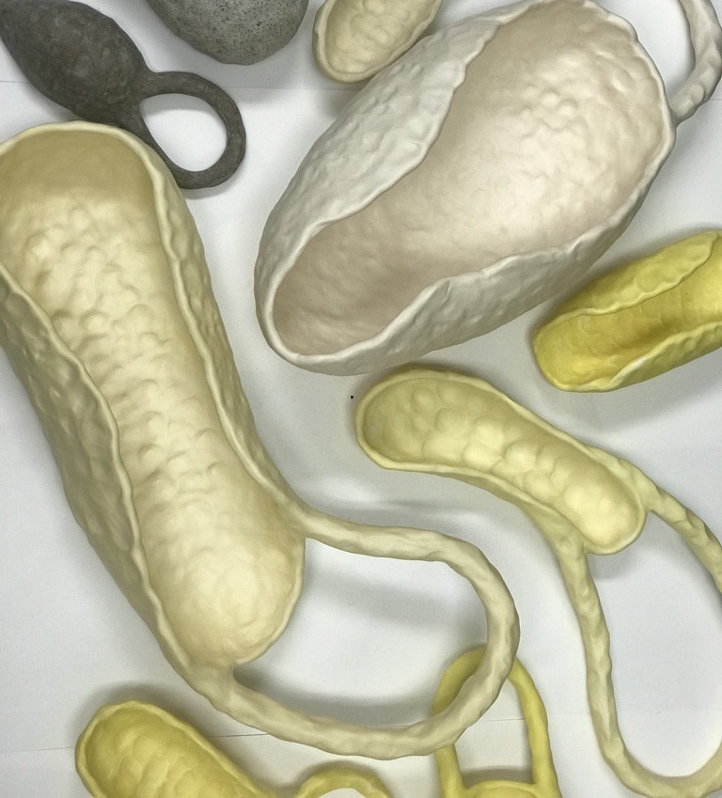

The Sensual Sheen
The why & how to of terra sigillata
Demonstrator:
Robyn Phelan
Australian Ceramics Triennale Conference WEDGE Walyalup (Fremantle)
October 2025
Link to notes

Slide 2
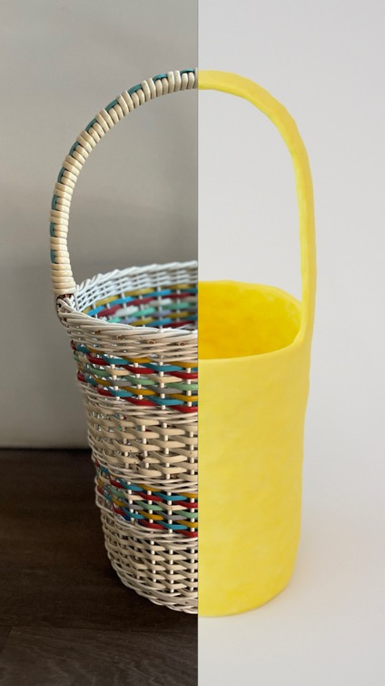
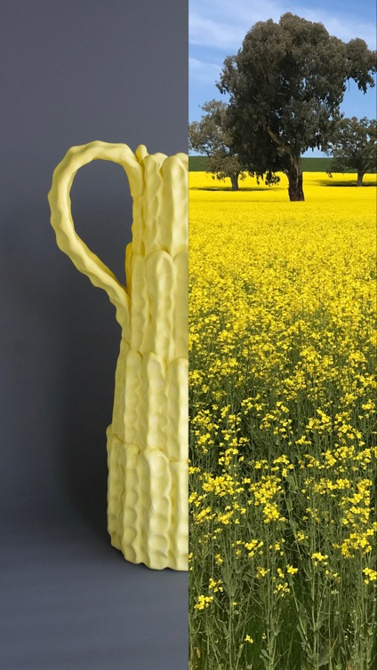
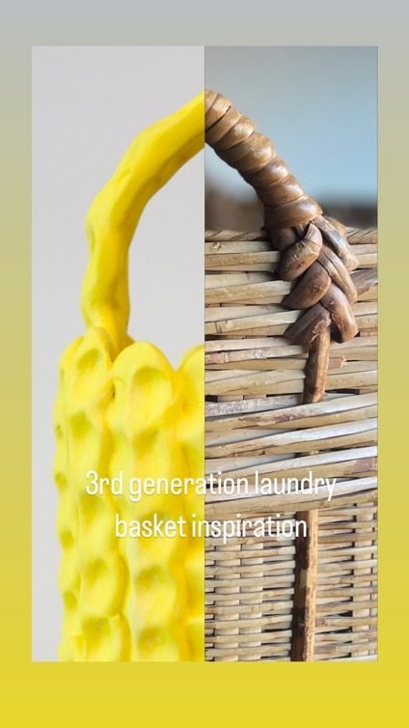
Intro Song : 'It’s a trick of the light’, 1986, The Triffids, West Australian

Slide 3
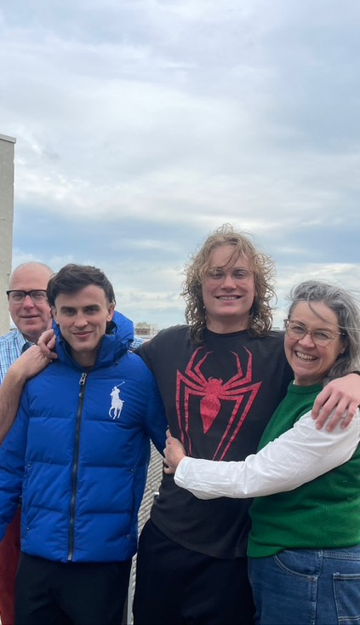
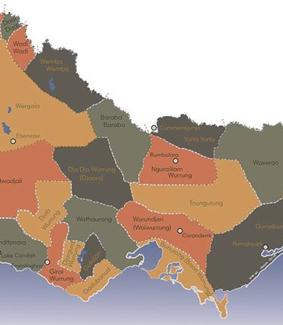
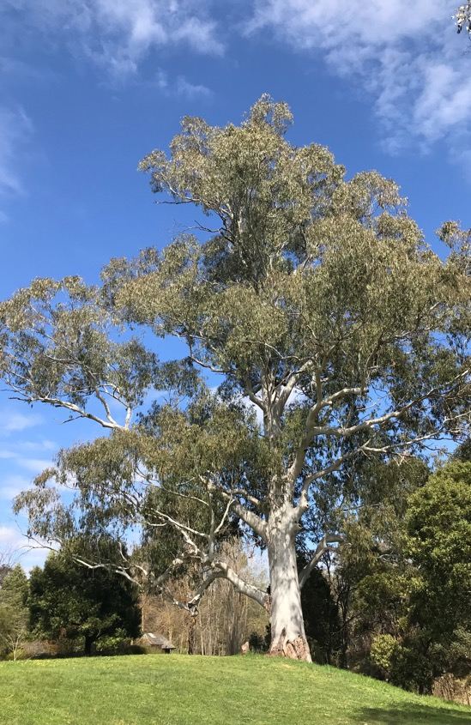
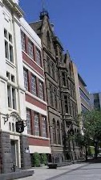
Acknowledgements
Unceded lands of Woiwurrung, Boon Wurrung, Taungurung People of Eastern Kulin Nation, thank you to elders past and present for custodianship of this land.

Slide 4
What is terra sigillata? Material definition:
The "colloidal or suspension effect" in terra sigillata is achieved by using a deflocculant to separate the finest clay particles from coarser ones. Finer particles stay suspended (electrically repelled) in the water and heavier sediment particles to the bottom.
This allows the potter to decant and use only the highly refined, colloidal-sized clay for a smooth, glossy, and polished surface when fired.
A colloidal liquid has very fine particles that form a dense layer after firing, resulting in the characteristic lustrous, glaze-like finish of Roman-era terra sigillata pottery and continues to be utilised as an aesthetic effect today.

Slide 5
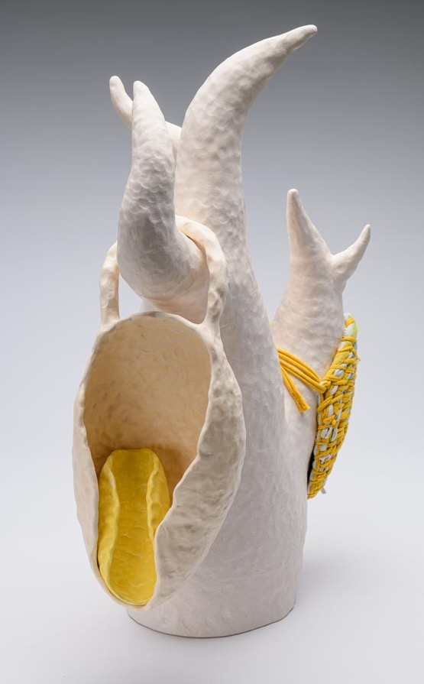
What is terra sigillata? Creativity, Uniqueness, Nerve & Talent:
Single clay sources – each clay body is distinctive, refined surface to you forms
Versatility of firing temperatures
Potential to combine with other ceramic surface treatments
Direct application and immediate result /response
Satin/way sheen to surface with or without burnishing.
Robyn’s love affair with sig
For lovers of the leatherhard stage
Skin-like finish
In the round forms without a glaze foot/ring
Retains & highlights making marks
Versatile
How to hold, how to carry and how to care, 2023, range of hand formed clays, terra sigillata, ceramic stain, hand-woven t-shirts, tea towels & pillowcases, h. 60 w. 36 d. 22 cm

Slide 6
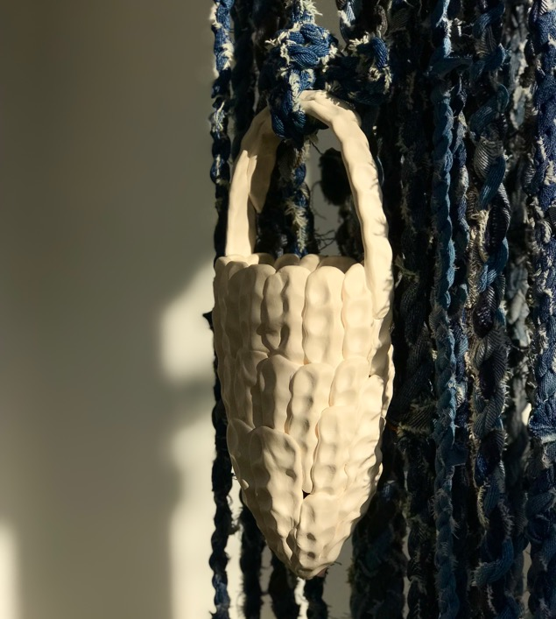
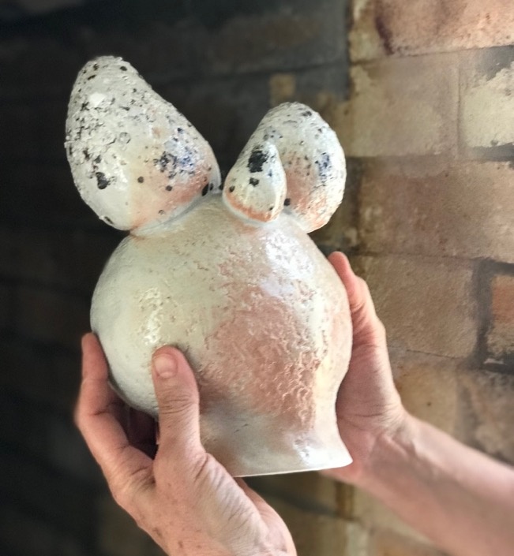
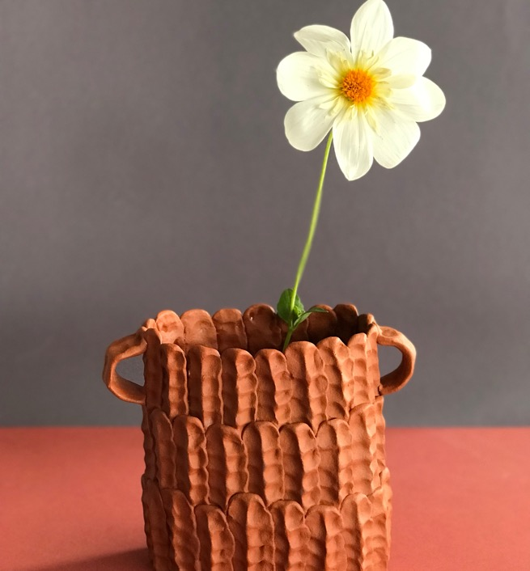
What is terra sigillata? Clay body definition:
Kaolin clays – such as a white stoneware clay will burnish well
Ball Clay – highly plastic mineral, warm & bright colour results
Red earthenware/terracottas – endless options
Self sourced clay – often lack workability. A sig surface offers site specific colours without forming challenges

Slide 7
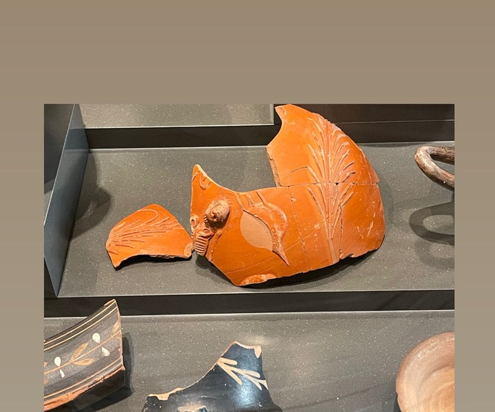
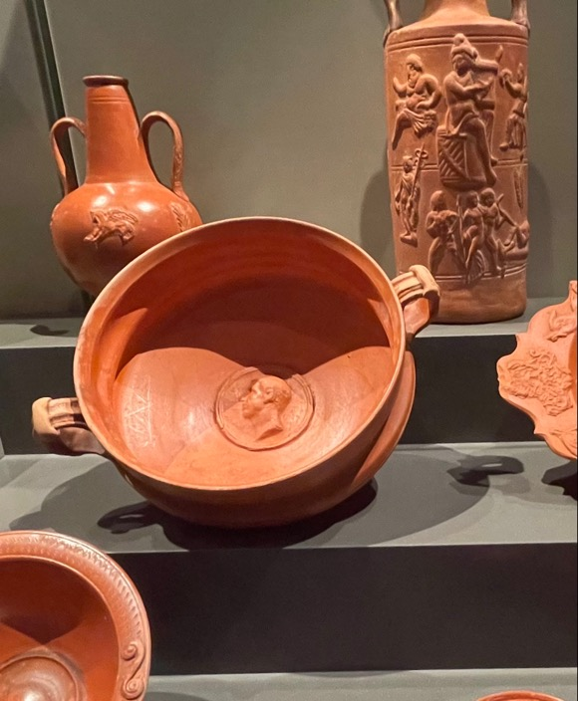
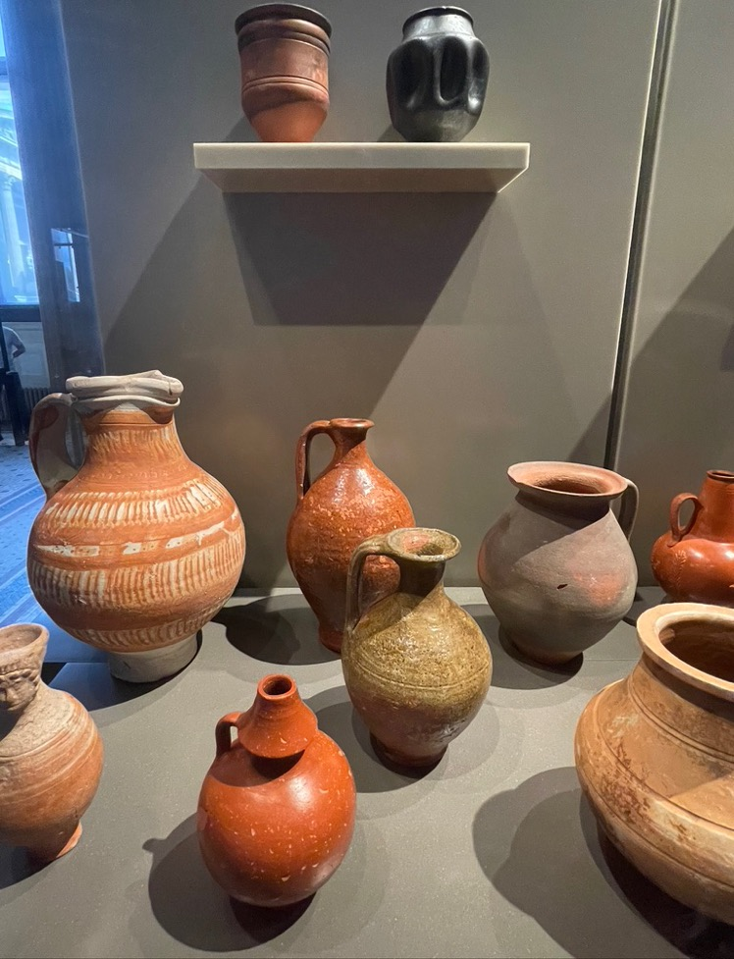
Terra sigillata hiding in plain sight – museum collections – ‘history & change’
Neues Museum Berlin July 2025

Slide 8
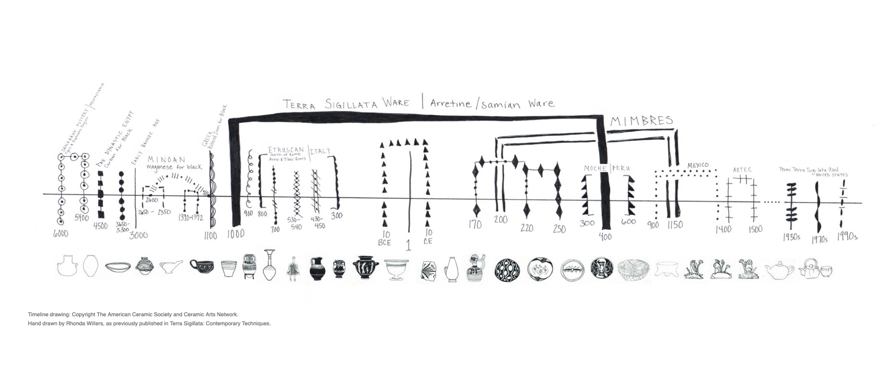
An ancient technique
Timeline acknowledgement Rhona Willers
Peter Pinnell & Rhonda Willers Terra Sigillata NCECA lecture 2018

Slide 9
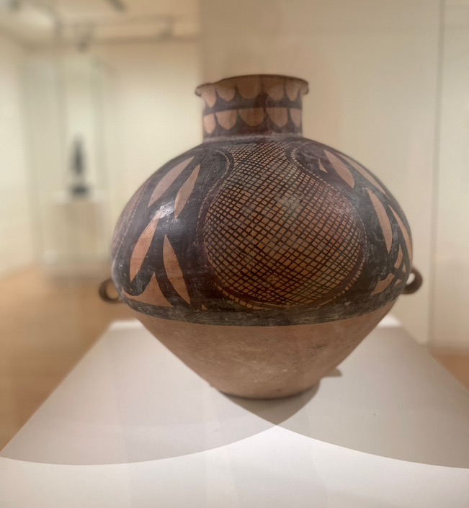
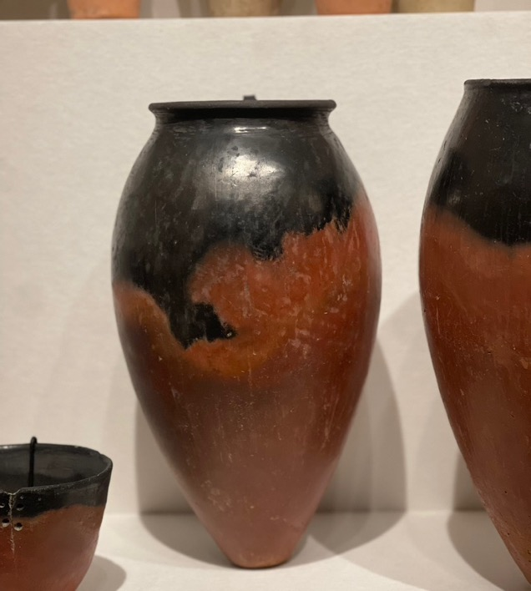
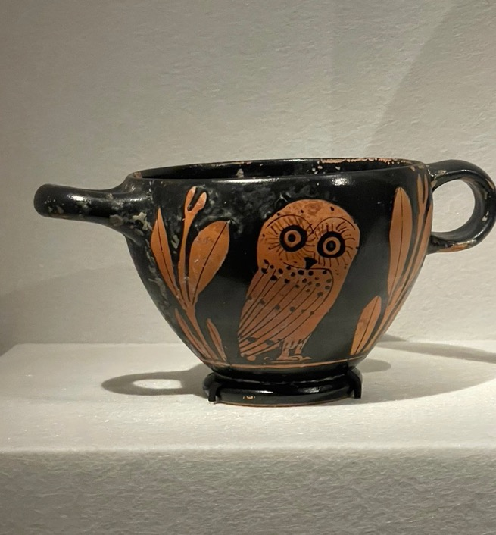
An ancient technique
Collection of National Gallery of Victoria, June 2025
Predynastic Egyptian (Nile River silt)
Attic red figure-ware Skyphos
Neolithic Chinese pot

Slide 10

Making Process & Equipment
EQUIPMENT
Large bowls/buckets ~ 8 litres, clear plastic bottles ~1-2 litres, grater, cutting wire, stick mixer, small and medium size scales, graduated cylinder or clear container~200mls.
PROCESS - MIXING INGREDIENTS
Allow plastic or wet clay to dry to leather or cheese hard.
Grate, slide into thin pieces.
Leave to dry to greenware
Slake greenware with measured water (mask on) ~20 minutes
Mix your preferred deflocculant into remaining warm water
Mix with a stick blender or paint mixer depending on scale
Leave sit undisturbed for 24 hours.

Slide 11
Process of Making & Equipment
DECANTING
Observe lines of sludge, terra sigillata and sig water
Decant using preferred method: siphon, pin hole, pour
SPECIFIC GRAVITY (the weight of clay particles in your liquid sigillata)
Tare your scale with cylinder of container on top.
Using a graduated cylinder weigh 100mls of tap water. Mark level if using a clear container.
Pour terra sig into same contain to 100mls mark. Check scale for weigh in grams.
Terra Sig likes specific gravity measurement in the range from 1.10 – 1.20 ideally 1.5
Formula: if your sig weighs 15 grams at the 100mls mark then your specific gravity is 1.5. (Just shift the decimal point across)

Slide 12
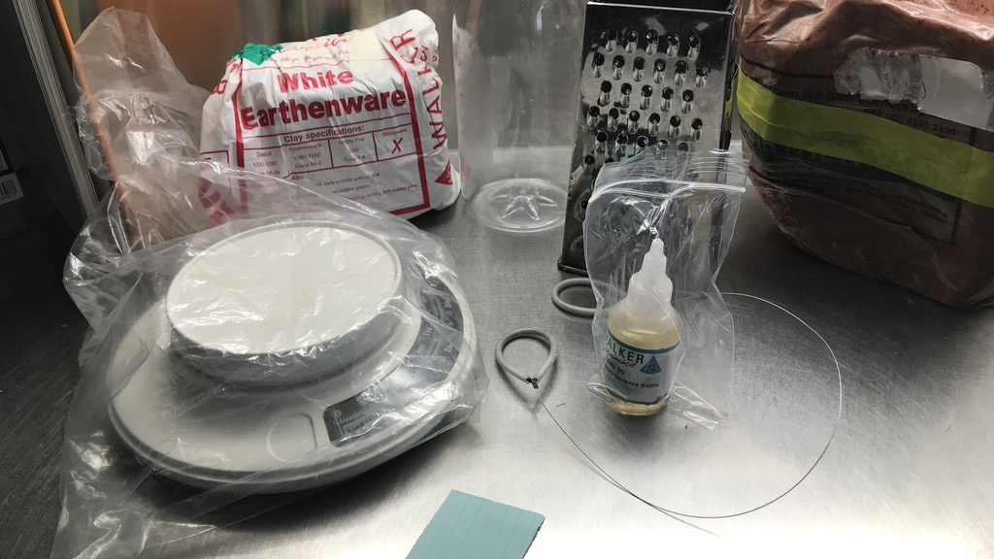
Basic equipment

Slide 13
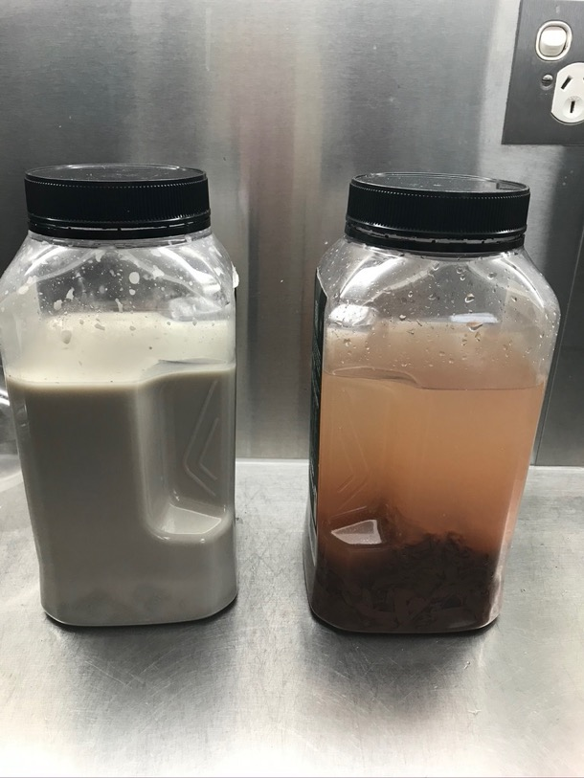
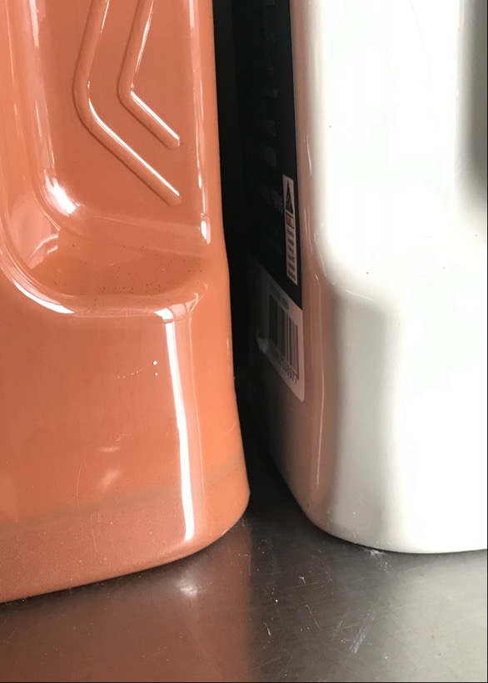
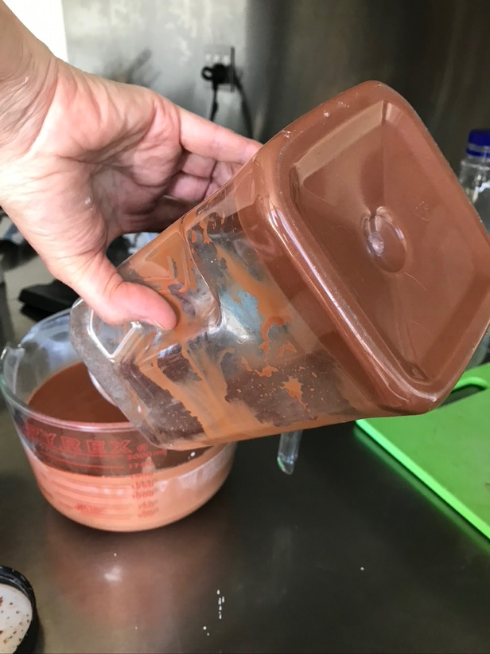
Basic process steep, settle, decant

Slide 14
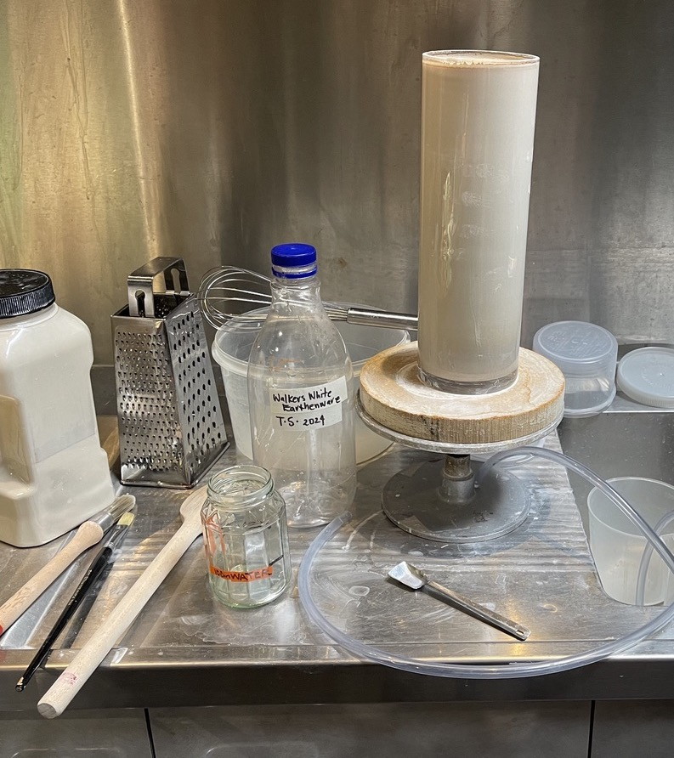
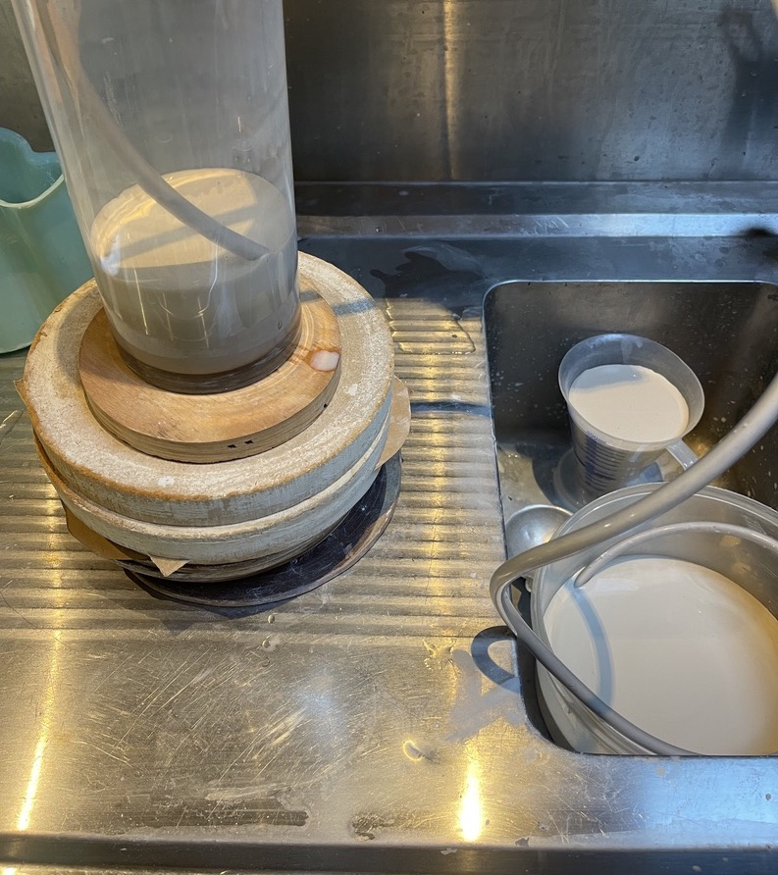
Siphon Method

Slide 15
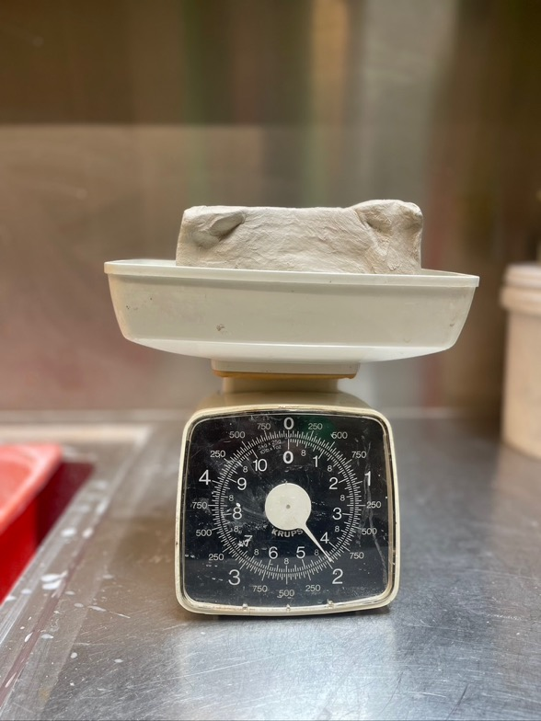
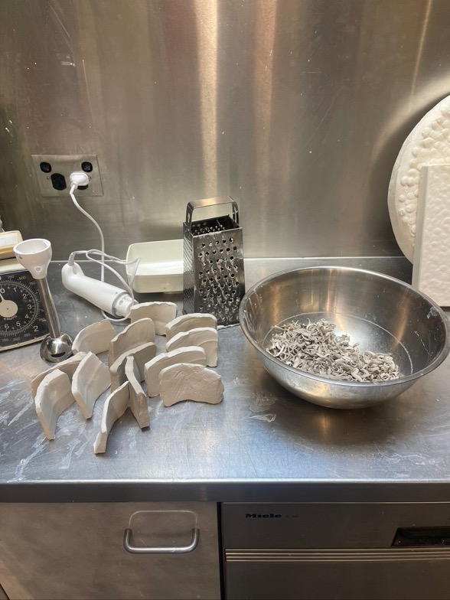
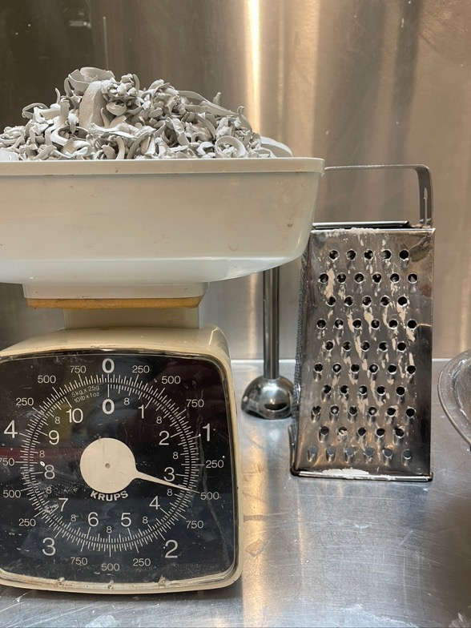
Step by step process
Grated or thinly sliced leatherhard clay
Walkers White Pottery
1.5 kg greenware
2kg wet clay

Slide 16
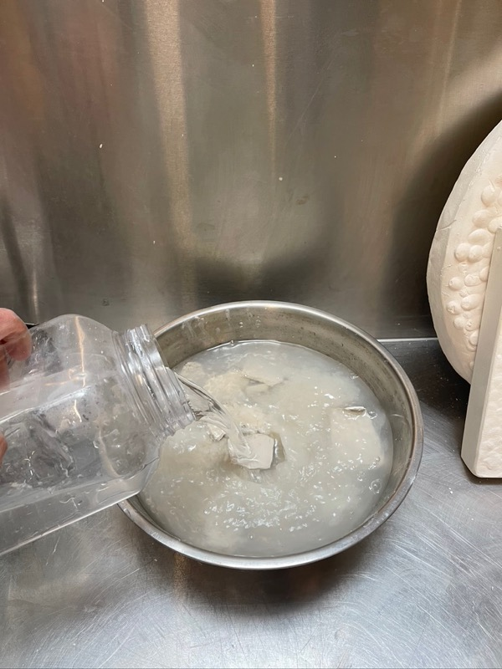
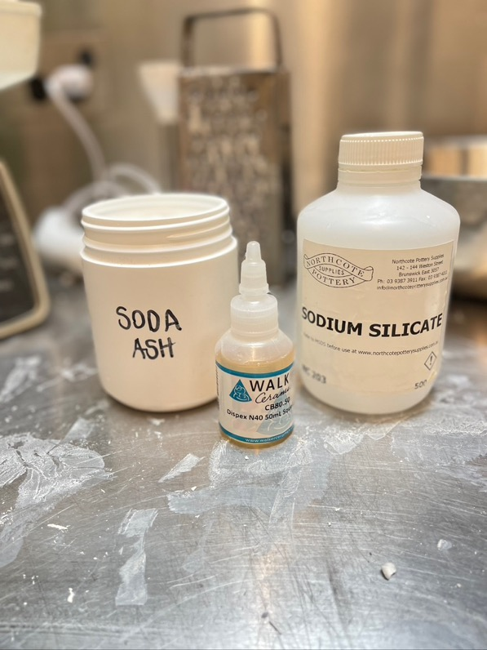
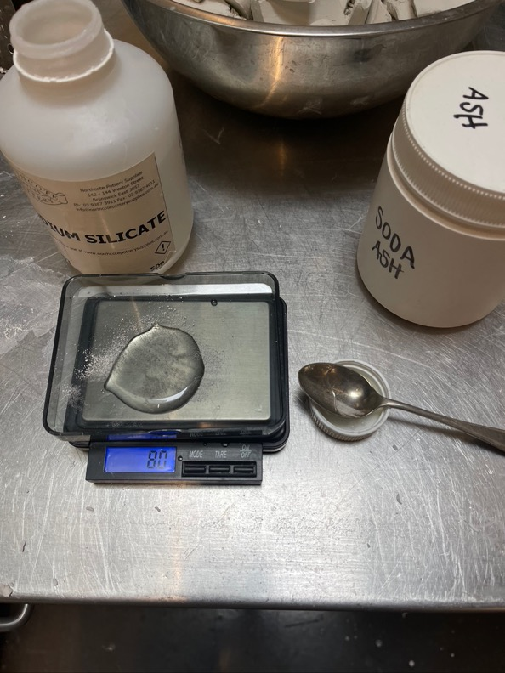
Step by step process

Slide 17
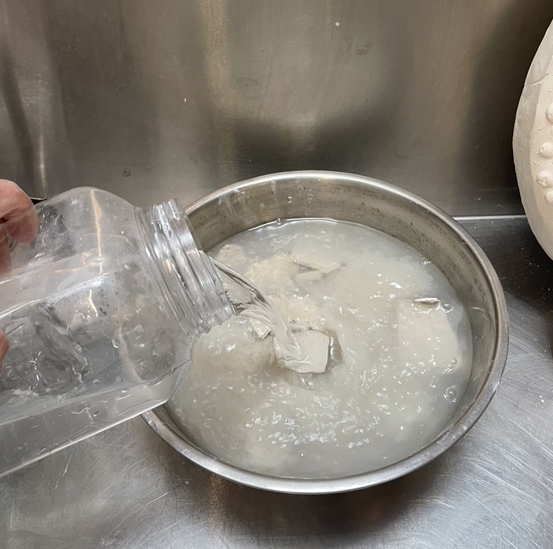
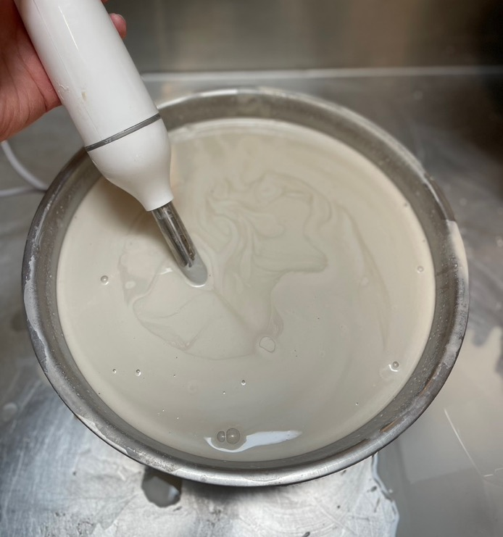
Step by step process 2000 grams plastic clay + 4 litres of warm water + 8 grams Sodium Silicate & 8 grams Soda Ash
4 litres waters
Slake greenware
Add sodium silicate & soda ash & dissolve
Add to slaked clay
Blend into an ‘oily’ mix

Slide 18
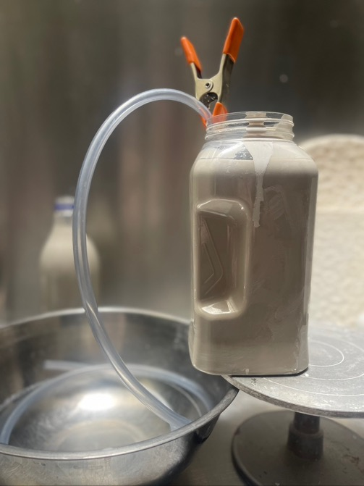
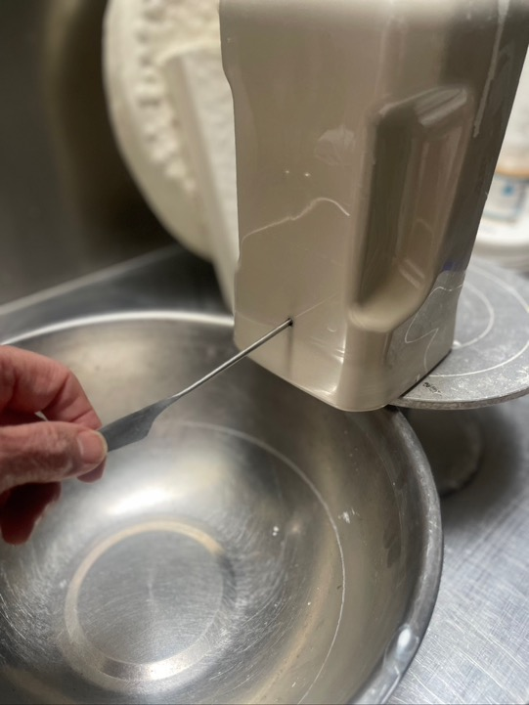
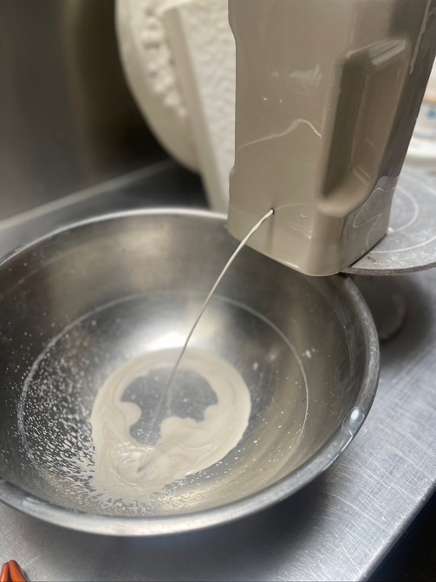
Step by step process Siphon or pin hold decanting

Slide 19
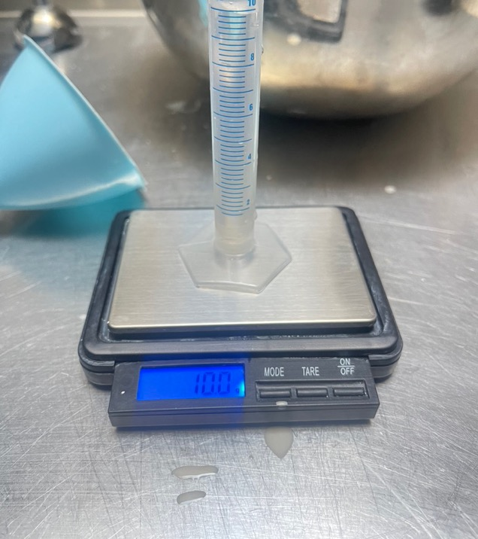
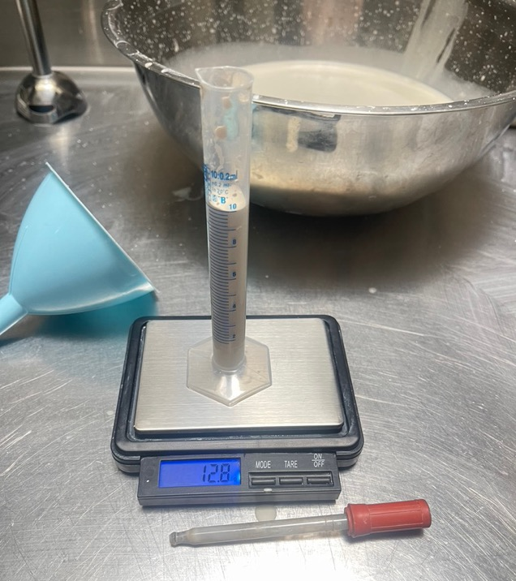
Step by step process Specific gravity (1.1 -1.50)
100mls terra sigillata weighs 128 grams
(best between 110-120 grams)
1.3 specific gravity( a little heavy)

Slide 20
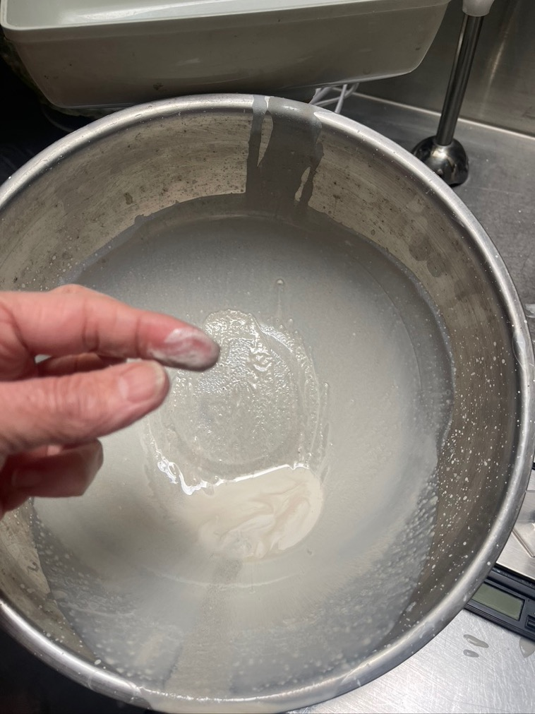
Step by step process – pouring If you see grit, stop pouring, clean out bowl and resettle to remove sediment

Slide 21
Making Sig – trouble shooting
WATER QUALITY If you have hard or heavy mineralised water you may have trouble with the deflocculation action. Test sodium silicate, Dispex or rDarvan (USA). Distilled water can be an option in small amounts/
SETTLING TIMES 8 hours minimum, 24 hours good rule of thumb, ball clays or white commercial clay up to 48 hours
TOO THIN Evaporate by pouring into an open bowl and tray.
TOO THICK Add water!
TOO GRITTY Resettle and decant. Add ½ more deflocculant, resettle 24 hours and decant.
WASTE Thin top layer can be used as an undercoat (Ref. Janet Deboos). Sludge can be used as a textural finish or returned into recycle ( in small amounts only)

Slide 22
RECIPES – materials in different ratios for stoneware clay
2000 grams plastic clay
4 litres of warm water
8 grams Sodium Silicate &
8 grams Soda Ash
1000 grams plastic clay
2 litres of warm water
4 grams Sodium Silicate &
4 grams Soda Ash
500 grams plastic clay
1 litres of warm water
2 grams Sodium Silicate &
2 grams Soda Ash
QR code for recipes via my website homepage

Slide 23
RECIPES – ball clay & self sourced clay
600 grams ball clay
1000 ml water
6 grams Sodium Silicate
1500 grams ball clay Ref. Jeremey Randall & Peter Pinnell, USA (quartered & rounded into metric)
1500 ml water
11 grams Sodium Silicate
400 grams sourced clay
I litre water
6 grams Sodium
2 grams Sodium Silicate
2 grams Soda Ash
Robyn’s In the Field Method
1 part clay
2-3 parts water (more water for heavier clay bodies)
½ teaspoon/drip per litre of water Sodium Silicate
½ teaspoon per litre of water Soda Ash

Slide 24
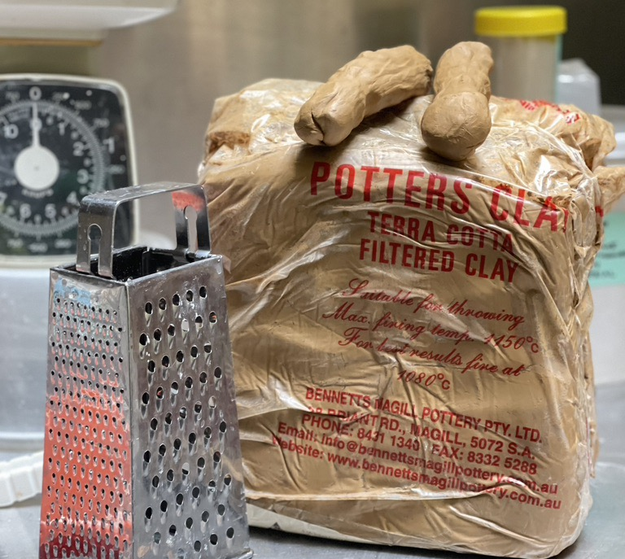
Demonstration clay Bennetts Potters Clay South Australia Terracotta

Slide 25
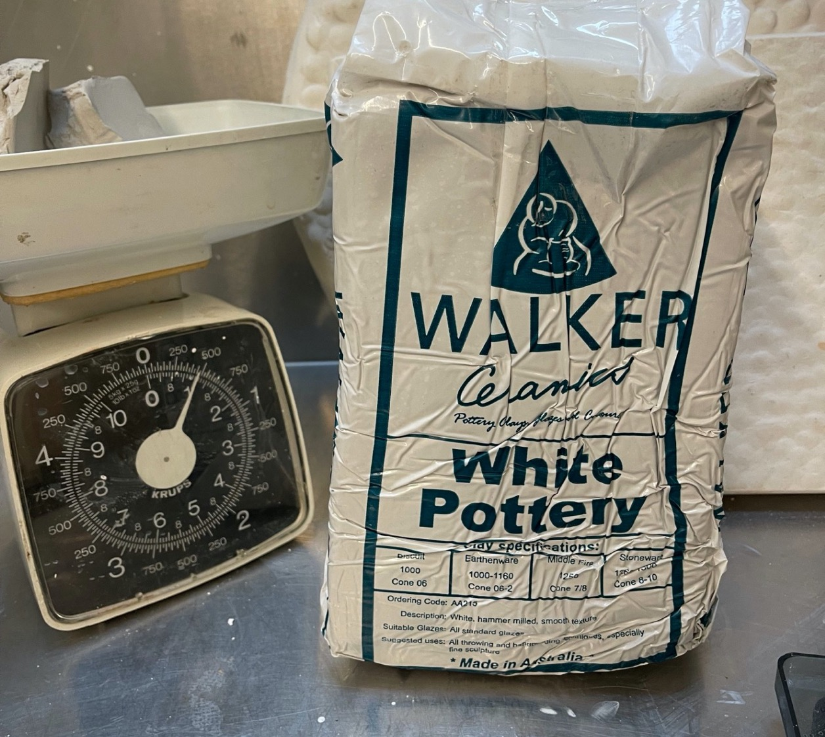
Demonstration Clay Walkers Clay Victorian White Pottery Hammered not filtered

Slide 26
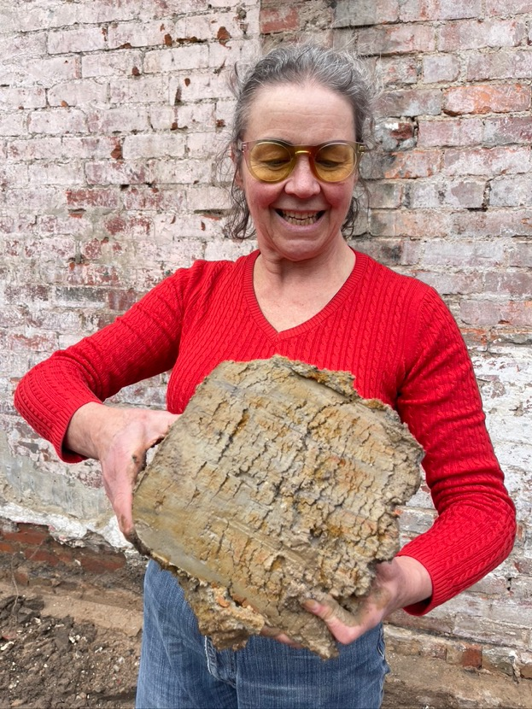
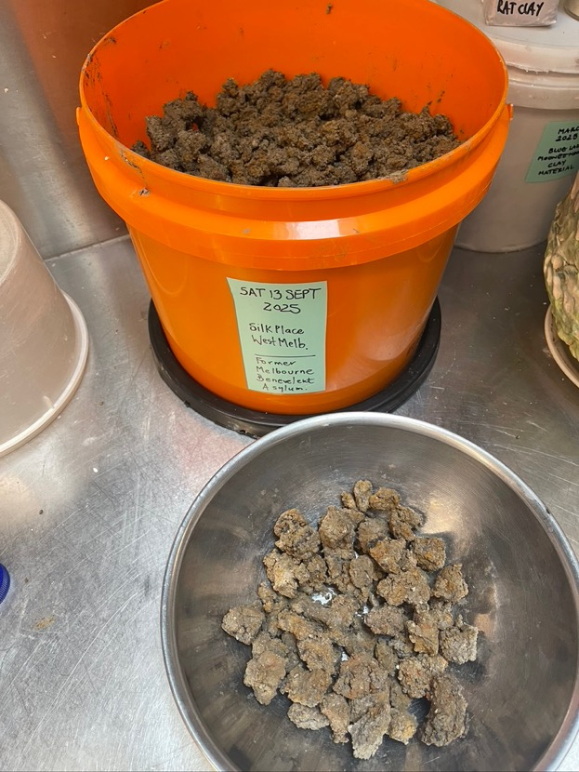
Self Sourced Clay
Neighbourhood foundation
digging opportunity
Drying & testing underway

Slide 27
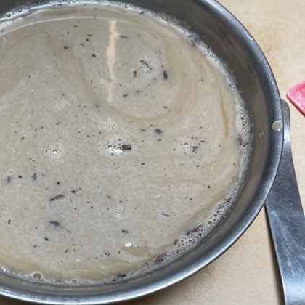
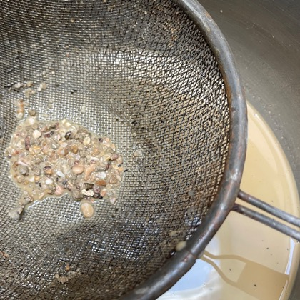
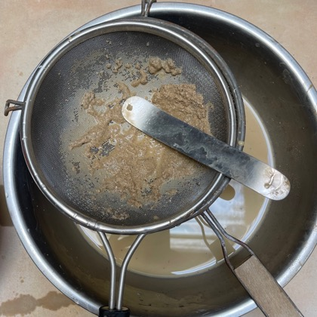
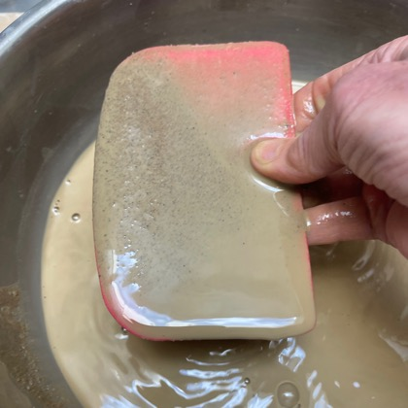
Preparing self source clay as a sig and body
Process underway.
SLAKE: remove floating organic matter | SIEVE: 2 times 2 meshes | SETTLE: | SIEVE: through cloth

Slide 28
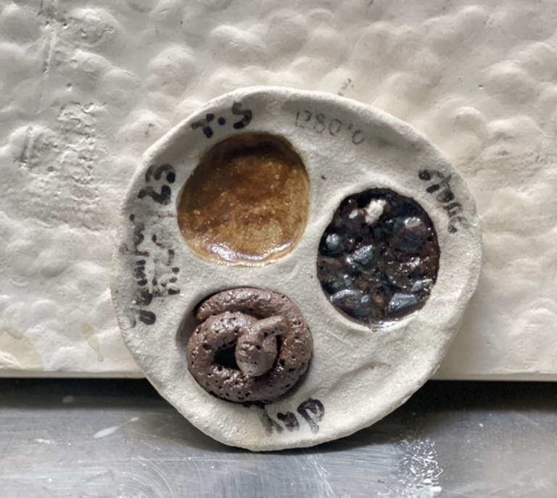

Self Sourced Clay Fitzroy renovation Testing: terra sig body gravel melt Fired to 1280$°$C in White Raku coaster

Slide 29
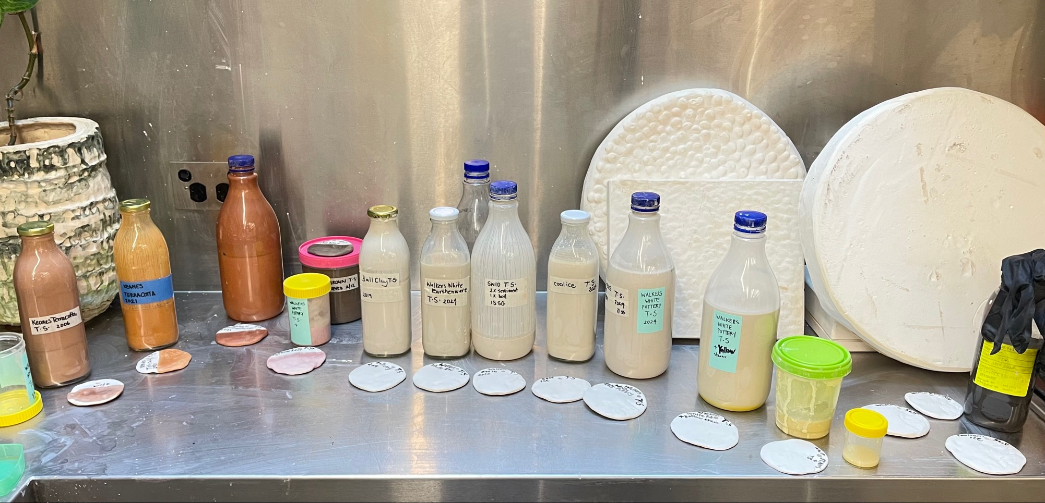
SUITE OF SIGS – brown, cream, white

Slide 30

Adding colour – stains
Stain in a modified oxide commercially made & a vast variety are available: Walkers Ceramics Online
Stains offer pure colour but each colour as its own burnt our temperature ~ 1200C, this is a bonus for sig which is a low fired technique.
Add to: slip & clay body >15%, glazes 5-10%, terra sigillata >15%
COLOUR INTENSITY ⬆️ ⬇️ SATIN FINISH WHY?
Stains colours are held stable and clean in refractory material, these are hard minerals (eg. zirconium silicate) which melt at high temperatures (1300 $°$C ). High percentages of stain in sig (over ~4%) for bolder colours is the introduction of ‘hard’ material rather than deflocculated / colloidal ‘soft’ materials.
TEST Hours of grinding in a mortar & pestle with no observable ‘softening’

Slide 31



Slide 32

Application
ON GREENWARE
1-5 LAYERS – increasing layers offer richer satin finish
BRUSHES – soft & fine!
DIPPING – quick at thin (1.2–ish specific gravity)
SPONGING – for difficult to reach or highly textured, can overlap and build up layers
SPRAYING – try it & get back to me!

Slide 33


Application: troubleshooting / testing
BASKET
2 layer on greeware
+ 3 layers on bisqueware
TEST TILE
6 layers on
~ no peeling or flaking
~ multiple layers & colours

Slide 34

Porosity – to burnish or not ?
WHAT?
Burnishing is rubbing action applied to the smooth form that compresses the fine, surface particles.
WHY?
Burnishing sig creates a glossy sheen. Can increase watertight-ness. Build up layers of burnishing based on aesthetic needs.
TOOLS?
Soft plastic, smooth stones, cutlery (metal traces will burn out) chamois, microfibre cloth, fingers.
HOW?
Burnish or ‘rub’ when clay ‘looks’ leather hard.

Slide 35

Treating porosity – chemical sealants
Liquid Quartz - food safe sealant specifically for low fired ceramics
- 50/50 video
Nanoman - Stone + Brick Protective Coating
Boncrete – sealing concrete
Silasec – permanent waterproof for masonry & concrete
All Australian made, non-hazardous, range of chemical actions

Slide 36


Sealed pottery- sculptural work
Rona Rubuntja b.1970, Panangka, Hermannburg Pottery.
Language: Auslan & Western Aranda Sign Language
Koprillia Day at Hermannsburg 2007.
Earthenware, hand-built terracotta clay with underglaze colours and applied decoration

Slide 37

Old school chemical sealants
Renaissance Micro-Crystalline Wax Polish
From the jewellers and conservation world for sealing marble, ivory, metals, gemstones, paintings.
Reversable?
Strong smell (white spirit) which dissipates, wear gloves apply in good ventilation

Slide 38




Slide 39


Porous pottery – burnishing traditions
MARIA MARTINEZ c.1887-1980, Tewa linguistic group and lived at San Ildefonso Pueblo, Santa Fe.
CRYSTAL BURNISH TOOL handed on from mother to daughter: cultural, spiritual, generational.
Storage Jar c. 1940
polished blackware with
matte black decoration

Slide 40

Old school chemical sealants
Mexican traditions
Burnishing stones, drenching oil and water, manganese slip, graphite and diesel plus stone burnishing.
Andy Ward’s Pottery You Tube
- tests linseed oil, pine pitch, bees wax
- a ‘replicator’ of traditional pottery skills

Slide 41


Porosity – vitrification definition:
950-1100 $°$C
Is the furthest stage to which a body can be taken without deformation.
At the vitrification point in the firing a body is usually in a malleable state…and is the result of melting and free silica in the clay body.
This molten silicate flows into the interstices between the clay particles and…begins to flux or fuse them.
(Ref Hamer’s Potters Dictionary 2004)

Slide 42

Porosity – sintered temperature
To fasten together by mutual adhesion without apparent fusion. From German language for cinder.
This explains its link with the partial action (partly burnt or partly fused)… All ceramic material pass through a stage of sintering before melting. There is no liquid phase involved and yet the individual particles stick to each other…The result is that materials which start as powders become solid at a temperature which is only half-way to the melting point…its actions can be seen in clays which melt above 1200$°C and yet have cohesion after being fired to only 600°$C…historically … and present day first nations societies use a low firing to produce cooking pots.
There is undoubtably some fusion of low-melting constituents, like fluxes but the strength is due to sintering and therefore has an elasticity not associated with glassy vitrification…used for cooking directly on fire…pots can be piled up in bisque firing without crushing. (Ref Hamer’s Potters Dictionary 2004)

Slide 43








Firing range potential to manage porosity
Testing
Walkers Stoneware 10 body with
Keanes Earthenware Sig
1000 $°$C
1100 $°$C
Sintered & porous
1220 $°$C
Towards vitrified
1240 $°$C
1280 $°$C
Vitrified non-porous
1220 $°$C
$$°$$
1000 $°$C
1280 $°$C
1100 $°$C
1240 $°$C

Slide 44



Slide 45


Terra Sig – your own research
Test tiles – match your form/texture/clay body
Horizontal format – no glaze melt
Application variety – 1, 2, 3 + layers
Documentation – photograph & note in journal

Slide 46



Anton Reijnders
2006-2010 fired clay, terra sigillata, tea cloth, glaze, rubber band, canvas

Slide 47


Anton Reijnders (NL) Because a medium mediates intrinsic meaning and assumptions we somehow have to deal with whether we like it or not. Probably because ceramics is a medium with a l ong history, it brings with it a wide range of meanings and assumptions like:
dirt, earth, affordable, low-status, hygienic, domestic, durable, non-heroic, sensual, responsive, fixed, identity-less, craft, hobby, high-tech, pleasing, precious, mass-produced. It is this large and partly conflicting range of meanings and assumptions that makes ceramics as an artistic medium so interesting.

Slide 48

Janet De Boos, AUS
…enjoy(s) using iconic imagery from the high point of Chinese porcelain decoration (Qing over glaze), colour & line from the deserts of Australia (Ernabella terra sigillata, Australian flora) and that most ancient of techniques from the ceramics lexicon (sgraffito or ‘scratching’) to create my hybrid pottery works that are both contemporary and timeless, culturally specific and yet borderless.
Qinghua Series, 2018 thrown Australian porcellaneous stoneware, Ernabella terra sigillata, Qinghua underglaze decals, blue underglaze, sgraffito, clear glaze, h. 53 d. 23cm

Slide 49

Image: Janet De Boos, road into Ernabella, South Australia

Slide 50



Farewell Song : Feels like We Only Go Backward, 2012, Tame Impala, West Australian

